Slide 1
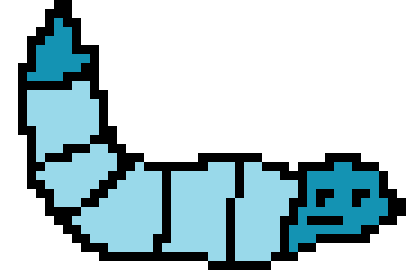

TETRIS
Now with 100% more worms…

Slide 2
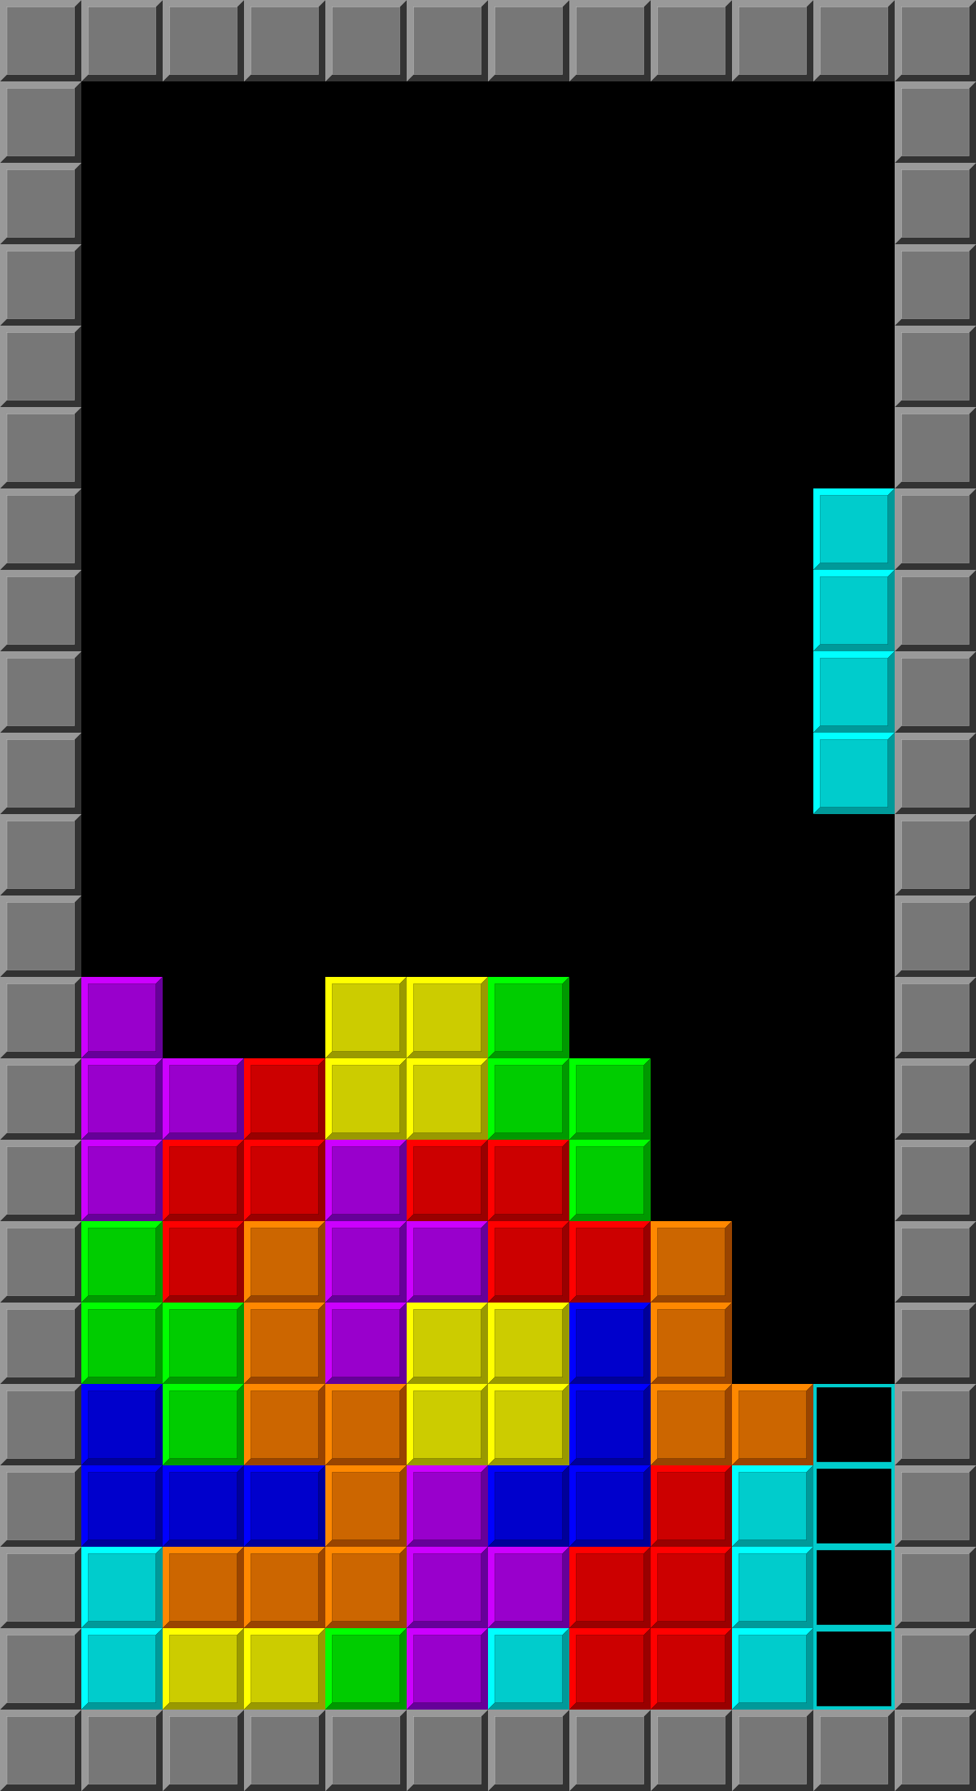

Have you ever been playing Tetris and thought to yourself…
Where are all the worms?!

Slide 3
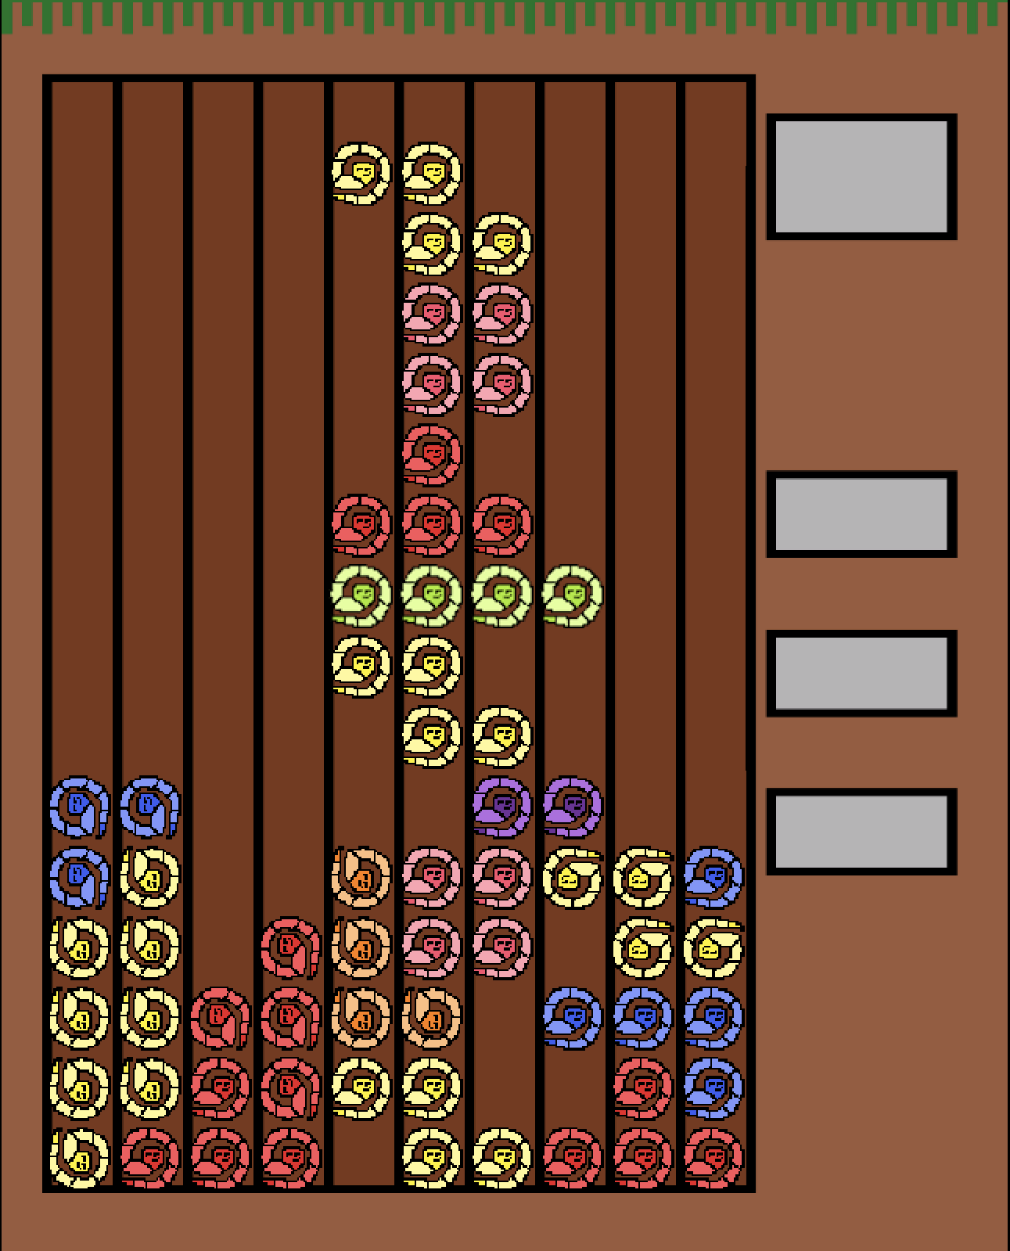
Look no further!!

Slide 4

Our journey…
Accidental Worm turned into worm idea

Slide 5
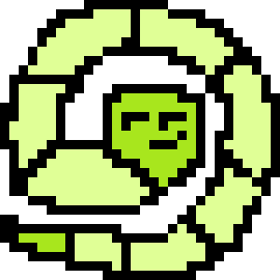
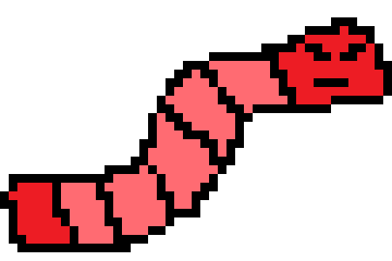
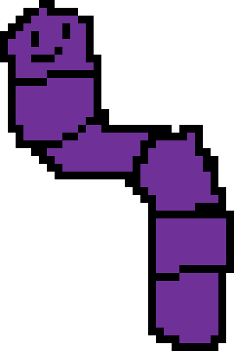
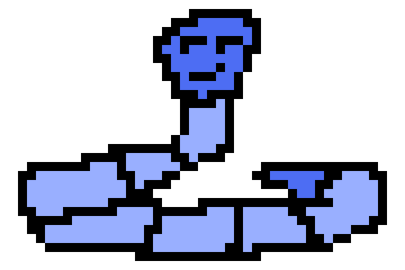
The features
Functional Tetris
Charming aesthetic
Worms
More Worms

Slide 6
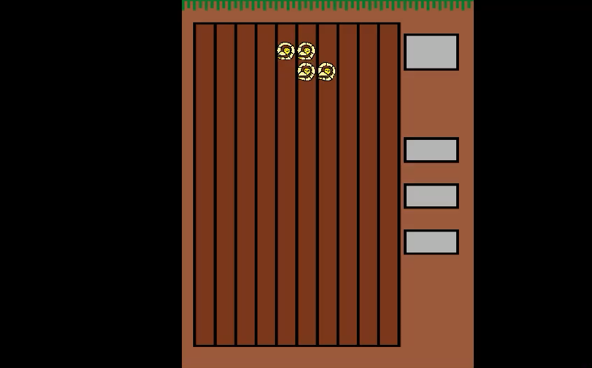
Thanks for Listening

